Slide 1
Computer Vision Metal Surface Defect Detection By Shri Prakash Yadav Mohammed Arhaam

Slide 2
Points of Discussion
Problem Statement
Data Summary
Dataset Exploration
Statical Analysis
CNN Model
SVM & Random Forest
Performance Comparison
Conclusion

Slide 3

Problem Statement
The quality assurance process in the manufacturing industry, particularly for hot-rolled steel strips, often faces challenges in identifying and classifying surface defects accurately and efficiently. Manual inspection is time-consuming, prone to errors, and not scalable for high-volume production environments.
The goal of this project is to develop a model for Metal Surface Defect Detection using the NEU Metal Surface Defects Dataset.

Slide 4
Data Summary
This dataset is a portion of NEU Metal Surface Defects Database which contains six kinds of typical surface defects of the hot-rolled steel strips. This dataset contains the classes given below:
Inclusion: Inclusion is a typical defect of metal surface defects. Some inclusions are loose and easy to fall off, some pressed into the plate.
Crazing: Crazing is the phenomenon that produces some cracks on the surface of a material.
Patches: A part of metal marked out from the rest by a particular characteristic.
Pitted surface: Pitting is a form of corrosion that focuses on a very small range of metal surfaces and penetrates into the metal interior. Pitting is generally small in diameter but deep in depth.

Slide 5
Scratches: A scratch is a mark of abrasion on a surface.
Rolled in scale: A rolled-in scale defect occurs when the mill scale is rolled into the metal during the rolling process.
The dataset is divided into train, validation, and test datasets. The training, validation and, test dataset contains 276, 12, 12 images respectively which sums to 300 for each defect.

Slide 6
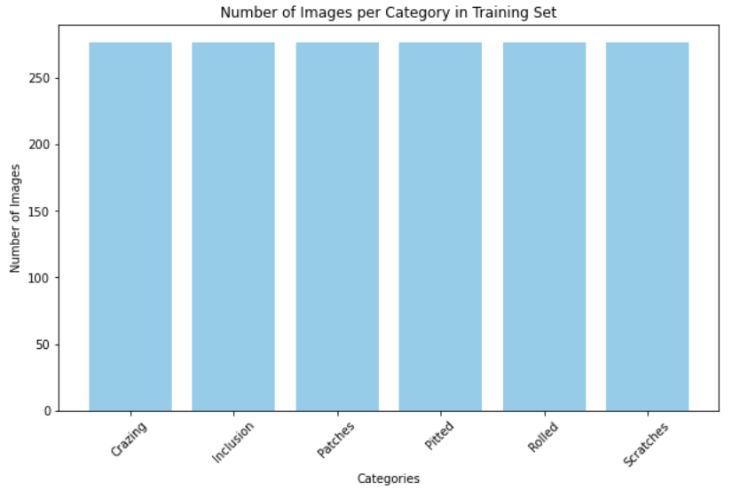
Dataset Distribution
The dataset is balanced. All classes contains same number of images.

Slide 7
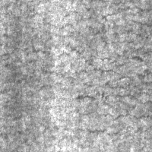
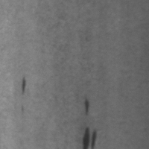
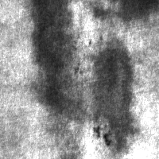
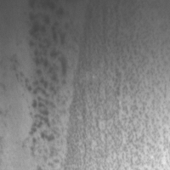
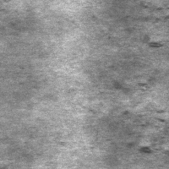
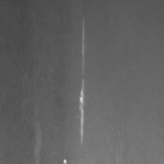
Defects
Crazing
Inclusion
Patches
Pitted
Rolled
Scratches

Slide 8
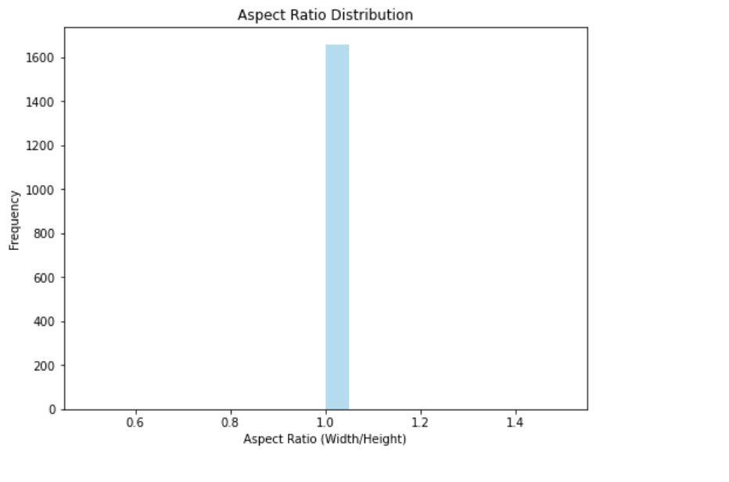
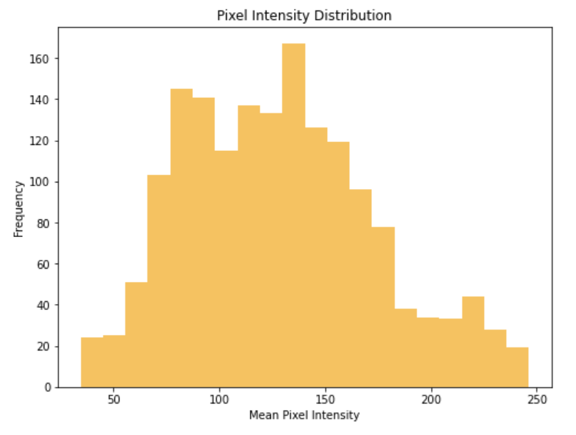
Aspect Ratio & Pixel Density Distribution
The spike at 1.0 indicates that all of the images have an aspect ratio of 1, meaning they are square (width and height are equal).
Most images have mean pixel intensities between 50 and 180, indicating that the dataset contains images that are predominantly of medium brightness.
There are fewer very dark (low intensity) or very bright (high intensity) images.

Slide 9
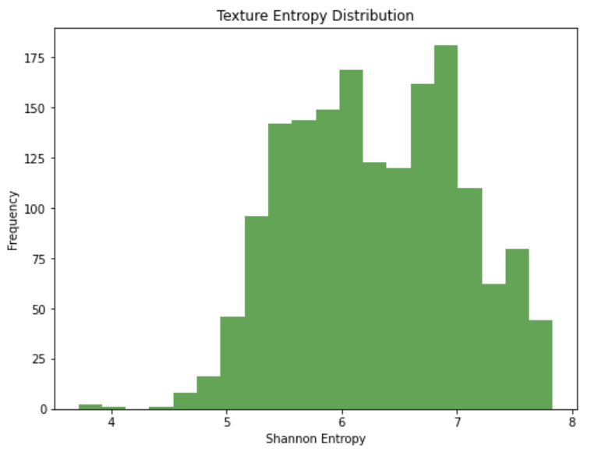
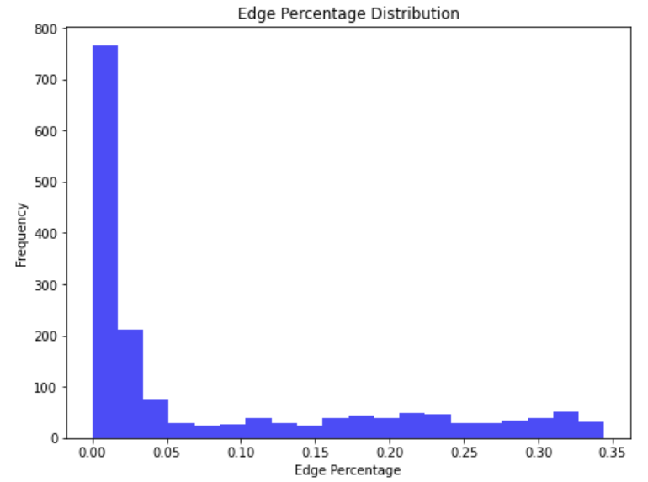
Entropy Distribution & Edge Percentage Distribution
Most images have entropy values between 5 and 8, suggesting the majority of our dataset contains moderately complex textures or patterns. Few Low-Entropy Images suggesting that there are not many images with very simple or homogeneous textures.
The distribution is skewed towards lower edge percentages, which indicates that many images are smoother or less detailed.

Slide 10
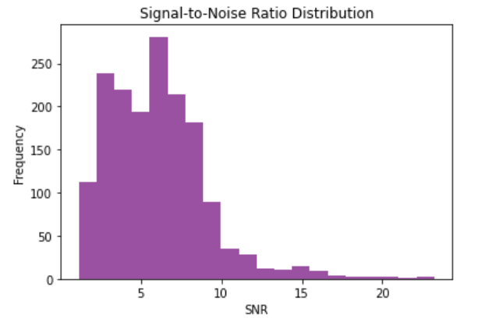
Signal-to-Noise Ratio Distribution
Most images in our dataset have SNR values between 3 and 12, which indicates high to moderate noise levels in most of the images.
Very few images have SNR values greater than 15, indicating a very small number of clean images.

Slide 11
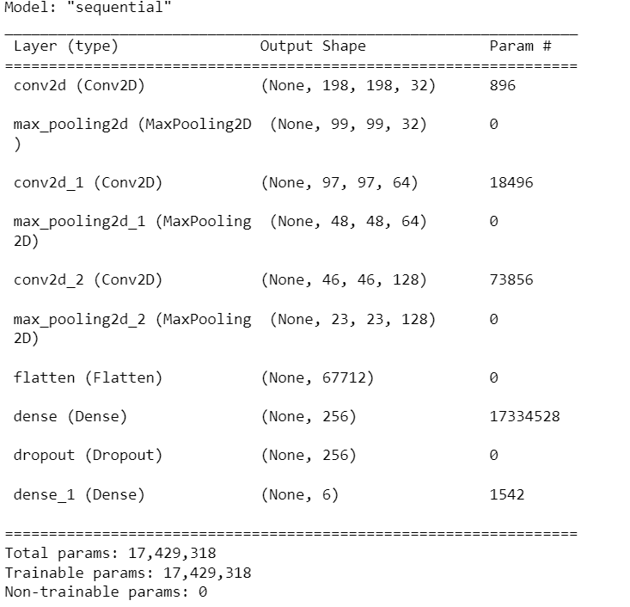
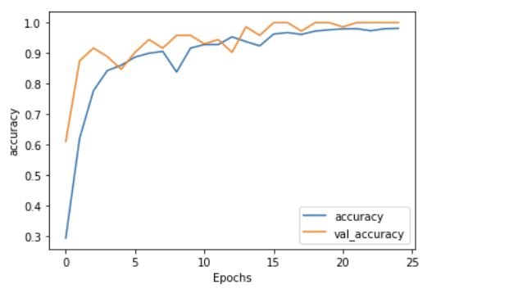
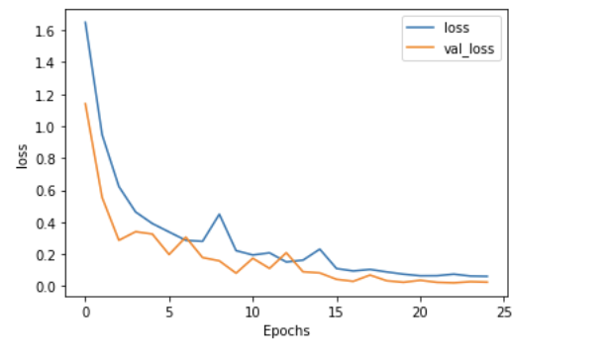
CNN Model
The accuracy on the unseen test data is 96%.

Slide 12
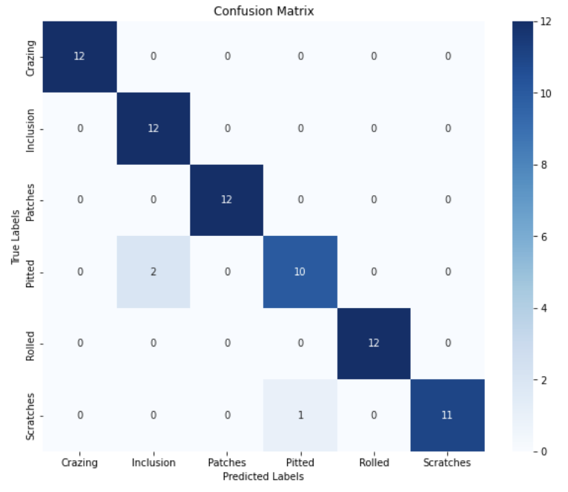
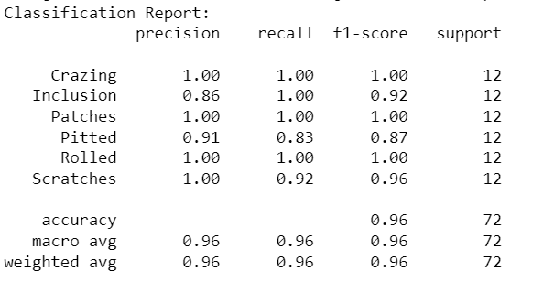
CNN Model
Crazing," "Patches," and "Rolled" defects have perfect scores (1.00 for precision, recall, and F1-score), meaning they were classified perfectly.
"Inclusion" has lower precision (0.86) but perfect recall (1.00), meaning some predictions were false positives.
"Pitted" has slightly lower recall (0.83), meaning some actual "Pitted" defects were misclassified.

Slide 13
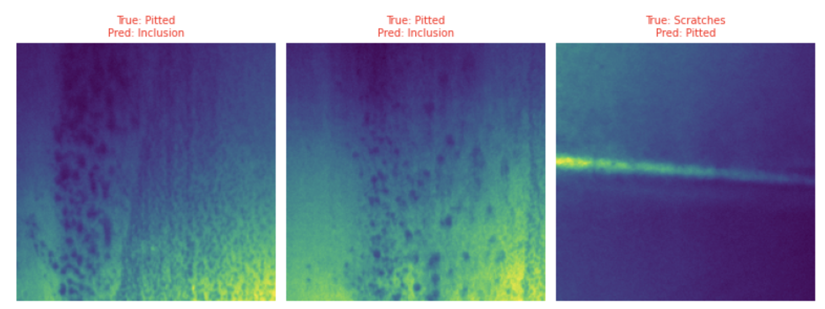
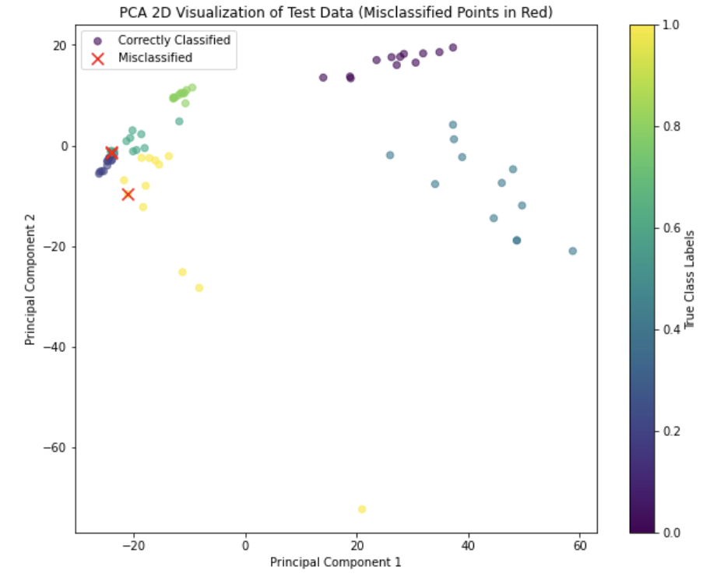
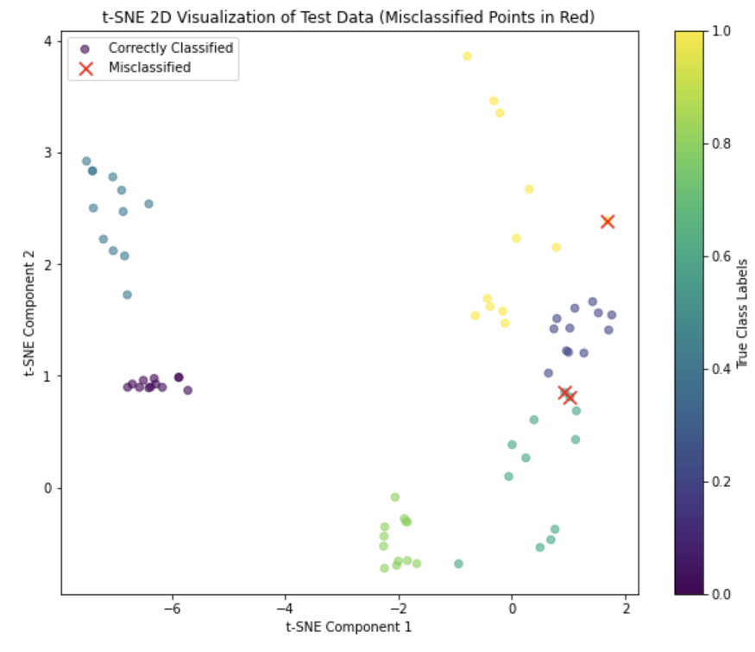
CNN Model

Slide 14
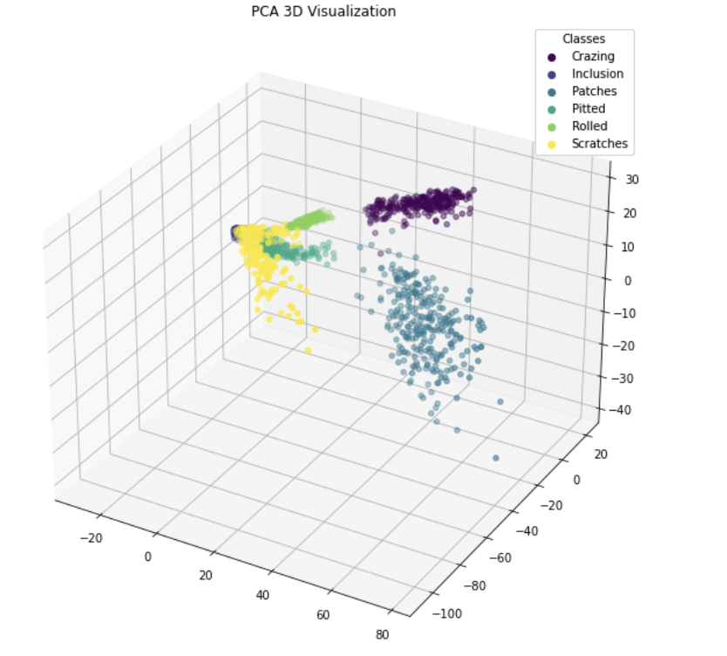
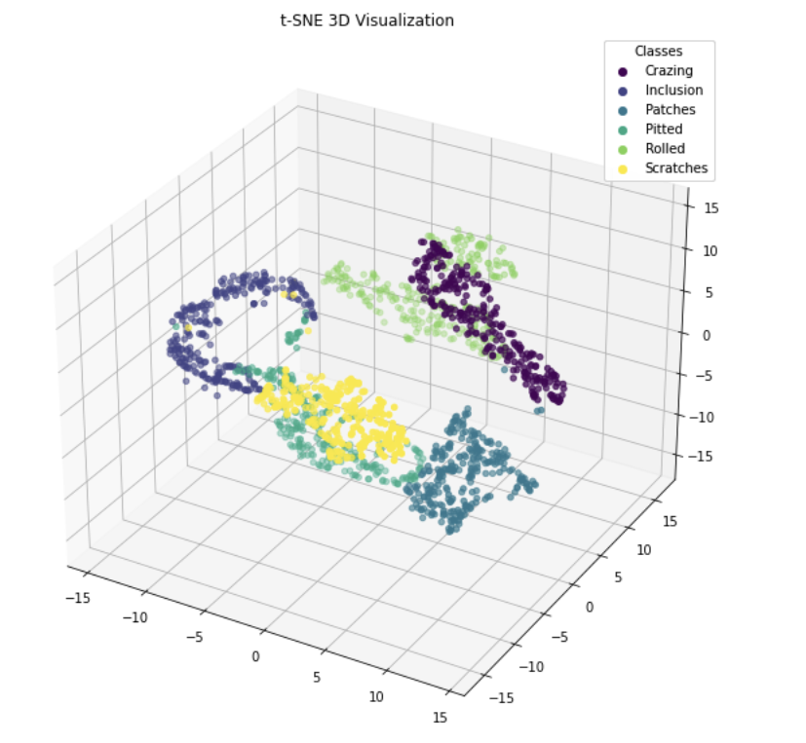
We passed the images through the CNN model and take the output from the second last layer and see how well the model has learned different class embeddings.
We can see that the model has learned some nice class embeddings.

Slide 15
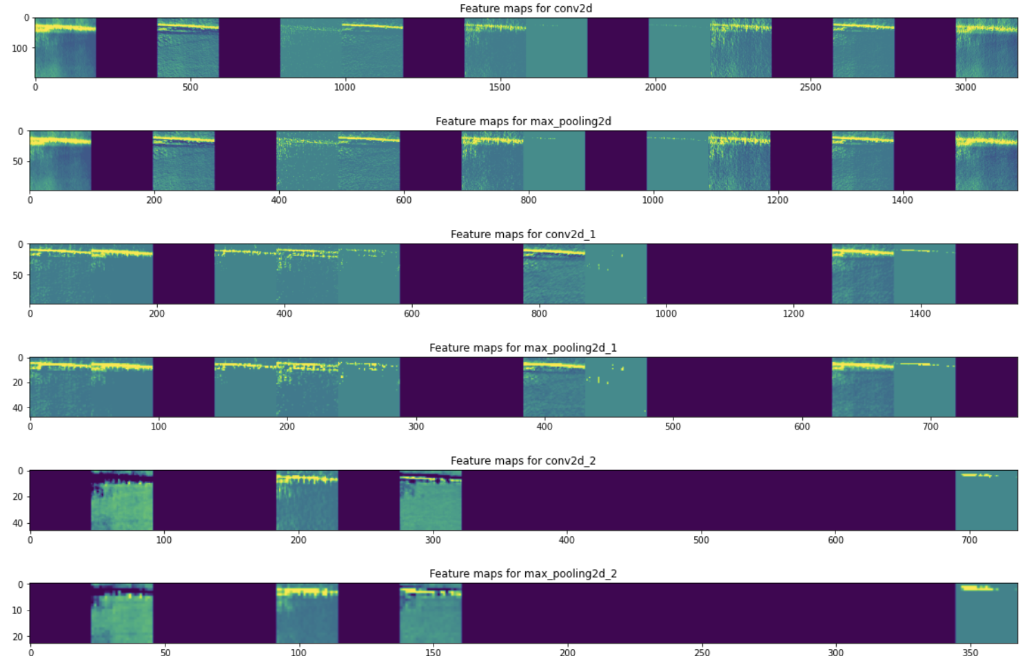
CNN Model
Feature Map:

Slide 16
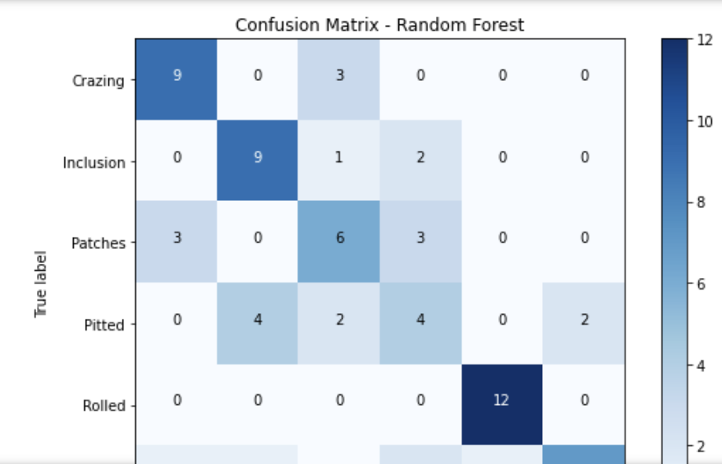
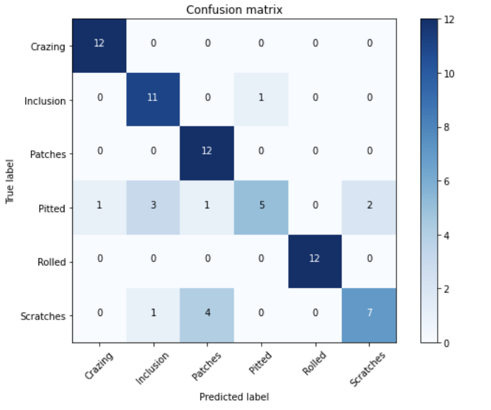
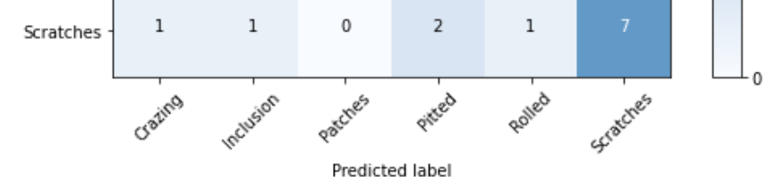
SVM & Random Forest
Accuracy - 80.55 Accuracy - 67.40
SVM Random Forest

Slide 17
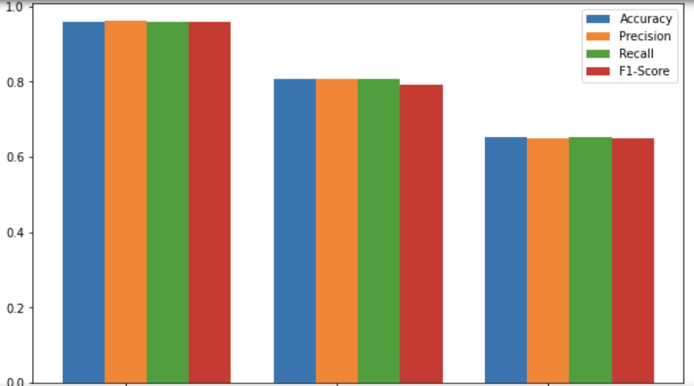
Comparison

Slide 18
Conclusion
We trained three models SVM, Random Forest and CNN for our image classification problem.
The accuracy for test dataset of our models are as following
SVM - 80.5 %
Random Forest – 67 %
CNN - 95.8 %
In our case the SVM model outperforms Random Forest the possible reasons could be
SVM is particularly effective in handling high-dimensional datasets, where the number of features is much greater than the number of samples, whereas Random Forest may struggle with high-dimensional data because it tries to split on features, and many splits may be noisy or irrelevant in high-dimensional spaces.
SVM, especially with the RBF kernel, excels at creating a decision boundary that maximizes the margin between classes, whether the data is linearly or nonlinearly separable, whereas Random Forest uses axis-aligned splits, which may not work well if the decision boundary is complex or curved.
Our models are generally confused between two sets of images Scratches with Patches and Pitted with inclusion this could be because of high similarity between these two set of images. Simple models are not able to capture the difference but CNN model is able to capture the difference.
The best performing model is CNN which is able to classify most of the images correctly. The obvious reason is the Convnets which are able to capture features better that machine learning models.

Slide 19
Thank You

